Slide 1

Genesis: Synthesizing Forwarding Tables in Multi-tenant Networks
Kausik Subramanian
Loris D’Antoni, Aditya Akella
Notes:
Introduce co-authors.

Slide 2





Cloud Network
Enterprise
Network
Network
Policies
Enterprise
Network
Notes:
With the advent of cloud computing, enterprises are moving their onsite infrastructure, including their network infrastructure to public clouds to offload various responsibilities to cloud providers. Our work focuses on the migration of the network infrastructure to the cloud. <N>
Enterprise networks enforce various network policies <N>, and the cloud operator must ensure these policies are also satisfied in the cloud network. <N>
An important feature of these clouds is multi-tenancy, that is the cloud network is shared by different tenants <N>
and thus, each of these tenants’ policies must be enforced in the cloud.

Slide 3
Tenant Network Policies
Enterprise
Network
B
A
Reachability:
A can talk to B
Waypoints:
C to B traffic goes through a Firewall
C
Notes:
Let us see look at some common policies specified by the tenant. <N>
The most basic is reachability, which says a host machine can talk to another host machine, therefore the network must provide a path from A to B <N>
The tenant can specify waypoints, for example the path from C to B passes through a firewall for security considerations.

Slide 4

Cloud Network Policies
S₁
S₂
Tenant 1
Network Policies
Tenant 2
Network Policies
100Gbps
100Gbps
S₃
S₄
S₅
S₆
Network isolation:
Tenant 1 and 2’s traffic must not affect each other
100Gbps
100 Gbps
100Gbps
S₇
S₈
S₉
S₁₀
Network resource management
Fault tolerance
Notes:
The cloud network operators needs to enforce a more complex set of policies. <N>
First of all, they must enforce all network policies specified by each tenant using the network. <N>
Because the network is shared among entities, tenants may require some notion of network isolation to prevent interference by other tenants <N>
Cloud operators also require policy support to manage their network resources like bandwidth consumption to accommodate more tenants. <N>
Finally, these networks are highly prone to failures, thus, tenants may request for fault-tolerance features.

Slide 5
Software-defined Networks
SDN Controller
Centralized controller
enforces policies
Programmable switch rules: Match: Packet headers Action: Forward to next switch
Enforcing policies using conventional distributed networks is difficult.
S₁
S₂
S₃
S₄
S₅
S₆
SSH traffic at S₃ is
forwarded to S₇
SSH
S₇
S₈
S₉
S₁₀
Notes:
Realizing policies using conventional distributed networks is difficult and programmable networks are better suited for these scenarios <N>
Software-defined networks were introduced primarily for this purpose. <N>
In a SDN, switch rules are programmable, where each rule contains a match predicate on packet headers,
And action specifies the next switch to forward the packet. <N>
For example, SSH traffic at switch S3 is forwarded to S7<N>
These rules can be configured by a central controller responsible for enforcing policies.

Slide 6

State of the Art
Program individual switch behaviors in SDN
Frenetic [ICFP11]
Hard to express network-wide behavior
Network-wide policies like regular paths (waypoints)
NetKAT [POPL14]
Cannot express hyperproperties like isolation
Complex network-wide policies like waypoints and bandwidth guarantees
Merlin [CONEXT14]
SIMPLE [SIGCOMM13]
Tailor-made and not easily extensible to new policies
Notes:
However, the SDN interface is too low-level, and many works improve the programmability of SDN. <N>
Frenetic is a SDN programming language which specifies individual switch behaviors, however, it is hard to express network-wide behaviour using Frenetic <N>
NetKAT is more expressive than Frenetic and supports certain network-wide policies, but it cannot express hyperproperties: properties which depend of multiple traffic classes like isolation. <N>
Merlin and Simple support more complex policies but they were tailor-made for specific policies, which makes it difficult to support new policies.

Slide 7
Support for complex
and diverse policies
High-level language to specify policies
Genesis
Switch forwarding tables
Extensible and generalized search
Enforcing certain policies is NP-complete
INPUT
OUTPUT
Genesis uses Satisfiability Modulo Theories (SMT) solvers
to synthesize forwarding tables
Notes:
Thus, we propose Genesis which tries to address
the cons of state-of-art works. Operators can specify policies
In a declarative manner using a high-level language and Genesis finds forwarding tables satisfying these policies. <N>
To meet the requirements of multi-tenant clouds, Genesis supports a set of complex and diverse policies <N>
However, enforcing certain policies is NP-Complete,
which may require custom heuristics for each policy-type<N>
Genesis has a generalized search technique which can be extended to support new policies.
The problem is still hard, but Genesis is not tailor-made for any specific type of policy. <N>
In the vein of program synthesis approaches, Genesis uses Satisfiability Modulo Theories (SMT) solvers
To synthesize forwarding tables.

Slide 8
Outline of the Talk
Motivation
Synthesis of forwarding tables in Genesis
Scaling to large workloads: Tactics and Divide-and-conquer
Genesis extensions: Handling failures
Notes:
Let us discuss the synthesis of forwarding tables in Genesis next,
Then various domain-specific optimizations to scale up synthesis. Finally, we would discuss some seamless
Extensions to Genesis for handling network failures.

Slide 9
Genesis Policy Support
S₁
S₂
Reachability:
G₁ can talk to G₂
FW
Tenant isolation:
No shared links
(NP-complete)
S₃
S₄
S₅
S₆
Waypoints:
B₁ can talk to B₂
Through FW
(NP-complete)
Traffic engineering
S₇
S₈
S₉
S₁₀
G₁
B₁
B₂
G₂
Notes:
We will look at some important policies supported by Genesis and the corresponding paths for these policies. <N>
Reachability: G1 can talk to G2, for which Genesis provides a path. <N>
The blue tenant specifies a waypoint for B1 to B2, and Genesis provides a path that goes through the waypoint. We supports ordered and unordered waypoints, and enforcing this can be as hard as the Hamiltonian path problem <N>
The two tenants can be isolated, and Genesis ensures that the tenant paths do not share any links, Enforcing isolation can be as hard
as the graph coloring problem <N>
Finally Genesis also supports resource management policies like traffic engineering to optimize utilization.

Slide 10
Synthesis Approach
Abstract Representation
High-level policies +
Topology
Forwarding tables
(Fwd, Reach)
Constraints on Fwd and Reach
Paths from Fwd and Reach solution
INPUT
OUTPUT
Notes:
We present the approach used by Genesis to synthesize forwarding tables <N>
We use two functions Fwd and Reach as a abstract representation of the forwarding behavior of the network. <N>
Genesis generates constraints on these functions based on the input set of policies, and the SMT solver provides a
Concrete solution to Fwd and Reach satisfying the constraints. <N>
From this solution, we can extract the paths, and correspondingly the forwarding tables.

Slide 11
Semantics of (Fwd, Reach)
Fwd(S₁, ID) = S₂: Switch S₁ forwards to S₂
Reach(S₂, ID) = 1: Specifies that S₂ is reachable in 1 step from source
Reach(S₁, ID) = 0
Reach(S₂, ID) = 1
Reach(S₃, ID) = 2
Fwd(S₁, ID) = S₂
Fwd(S₂, ID) = S₃
S₁
S₂
S₃
Paths extracted from the values of Fwd and Reach
Notes:
Let us understand the semantics of Fwd and Reach with the help of an example path indicated by the blue arrows. <N>
The Fwd function specifies the neighbour a switch forwards to, for example, Fwd of S1 for this traffic is S2, the next switch in the path.
Note that ID is a unique identifier for this traffic. <N>
The Reach function specifies the position of a switch in the path. In this case, S1 is reached at 0, S2 at 1 and so on.
Thus, these functions represent the paths for different tenant traffic, <N>and we can extract the paths satisfying the policies
From the values of Fwd and Reach

Slide 12
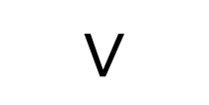
Reachability Constraints
S₃
Fwd(S₃, ID) = S₄
SRC
Reach(S₃, ID) = k - 1
DST
S₁
$$∨$$
S₄
S₅
Reach(S₂, ID) = k - 1
Reach(S₄, ID) = k
S₂
If a switch is reachable in k steps,
one of its neighbors must be reachable in k - 1 steps
Notes:
Let us look at how constraints on Fwd and Reach look like.
Given a reachability policy between src and dst, we need to add constraints to get a valid path from source to destination. <N>
Intuitively, conisder the switch S4, If S4 is reachable in k steps in the path, <N>
then either S2 or S3 is reachable at k-1 steps <N>
And if S3 is reachable in k-1, then Fwd of S3 would be S4, similarly for S2.

Slide 13
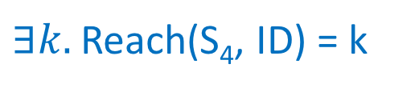
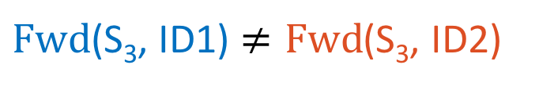
Policy Constraints
Waypoint: Blue Tenant 🀫 specifies path must traverse through S₄
$∃k.$Reach(S₄, ID) = k
S₂
S₄
Isolation: Blue Tenant 🀫 and Red Tenant 🀫 paths do not share any link
S₁
S₅
S₃
Traffic Engineering: Using SMT-OPT
$Fwd$(S₃, ID1) $≠Fwd$(S₃, ID2)
Notes:
Let us look at constraints for other kinds of policies.<N>
If the blue tenant specifies S4 as the waypoint, we add the constraint ”There must exists a k
Such that S4 is reached in k steps in the tenant path. <N>
To express isolation between the blue and red tenant paths, we ensure at a switch, that the
Next switch is not the same. This is expressed as Fwd(S3 for blue and red traffic must not be the same.<N>
More complicated policies like Traffic engineering can be specified using SMT with linear optimization objectives.

Slide 14
THE END?
Notes:
Is simply generating constraints and using SMT solvers enough to tackle the problem? Not quite.

Slide 15
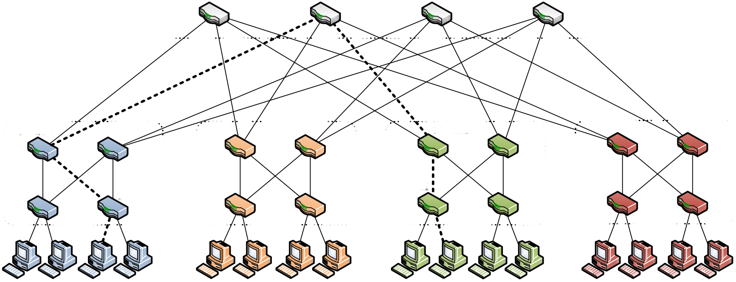
Baseline Synthesis Evaluation Setup
Genesis implemented in Python, uses Z3 SMT solver
Multi-tenant isolation: Each tenant has a single reachability policy, and all tenant paths are mutually isolated
Medium-sized fat-tree datacenter topologies
Notes:
Let us look at the baseline synthesis performance to understand why. By baseline, I mean
Generating constraints for policies and feeding it to the SMT Solver<N>
We implement Genesis in python and use the Z3 SMT solver <N>
We consider multi—tenant isolation workloads, where each tenant has a single path,
And tenants are mutually isolated, that is, not two tenant paths shared any links. <N>
We use medium-sized fat-tree topologies commonly used in datacenters.

Slide 16
Baseline Synthesis Evaluation
To scale to large networks and workloads,
we need to further optimize synthesis performance.
Exponential
Complexity
Synthesis time for over 60 tenants takes >5000s
Notes:
The plot shows the synthesis time with increasing number of tenants. <N>
We can observe that the synthesis time for over 60 tenants can take more than 5000 seconds, which can be prohibitive<N>
Also, observe that the time is in logscale, and synthesis has exponential complexity <N>
Thus, we need to further optimize synthesis performance to scale to large networks and workloads.
Clairfy axes more

Slide 17

Scaling to Large Workloads
Tactics
Divide-and-Conquer
Notes:
So, simply using SMT and encoding constraints does not scale, so we use domain-specific knowledge for scaling up synthesis using two techniques called tactics and divide-and-conquer.
Operators with no idea about how SMT works can also use these features, which helps because operators don’t really have a clue about SMT :P
Let us take a look at tactics first.

Slide 18
Tactics: Motivation
Edge-to-edge paths: 272
Large search space
Core
Aggregate
Use network structure to specify path properties
Edge
Regular expressions using hierarchies
Notes:
Consider a common datacenter topology with three levels of hierarchy. <N> Hosts are connected to the edge level, and even for a 20-node topology, the number of edge to edge paths is very high, Thus the solver has to explore a large space of paths to find a solution <N>
The operator would ideally want to leverage the network structure to eliminate undesirable paths. <N>
Example, consider the path shown in the figure which traverses through another edge switch. In most cases,
these paths are not required, and Genesis must be able to prune as many undesirable paths as possible. <N>
We use regular expressions to specify tactics, and instead of using individual switches,
we use hierarchies for the alphabet set to abstract the topology, For example: the set in this case is core, aggregate and edge. This generalizes the tactic and simplifies the work of the operator.

Slide 19
Tactics: Examples
Core
Aggregate
Valley-Free Tactic:
Edge Agg Core Agg Edge
No Edge Tactic:
Not (Edge .* Edge .* Edge)
Very restrictive;
short paths
Edge
Less restrictive;
longer paths
Notes:
Let us look at two examples of tactics for the fat-tree topology. <N>
A natural tactic valley-free tactic specifies that the path must go from edge to core and back to edge once, this is the best path <N>
This is a very restrictive tactic, and we may not find a solution if this tactic was enforced. <N>
Another tactic is the No Edge tactic which says an edge-edge path does not have an intermediate edge switch. <N>
This tactic is less restrictive than the valley-free tactic but permits longer paths

Slide 20
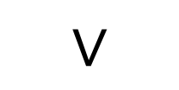
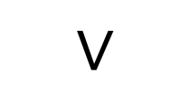
Tactics: Constraint Reduction
Genesis uses tactics as a search
strategy to eliminate constraints
Reach(C₁) = k - 1
C₁
No Edge Tactic ensures no intermediate edge switch
$$∨$$
Reach(S) = k
Reach(A₁) = k - 1
A₁
S
$$∨$$
E₁
Reach(E₁) = k - 1
Notes:
Genesis uses tactics to eliminate constraints and acts as a search strategy, this is different from other works which use regular expressions as a specification and require adding constraints. <n>
Let us see how constraints are reduced. Constraints are added such that if switch S is reachable in k steps<N>
One of its neighbours is reachable in k-1 steps <N>
Consider the no edge tactic. Since there are no intermediate edge switches, <N>
We can remove edge neighbours from the disjunction <N>

Slide 21
Tactics: Properties
Specified using a restricted regular expression syntax
Sound heuristic (paths satisfy tactic regular expression)
Complete (if a solution exists where the paths satisfy the regular expressions, Genesis will return one)
Policy-agnostic optimizations
The operator can develop a repository of tactics based on their topology structure for reuse
Notes:
As we envision tactics as optimization, we support a restricted regular expression syntax, any expression using this syntax will prune constraints.<N>
Tactics are heuristics but we prove its soundness i.e., solution paths will satisfy the regular expression, <N>
The optimization is also complete i.e., if there exists a solution where the paths satisfy the tactics, Genesis will return one. <N>
One of the key features of tactics is that it is policy-agnostic and depends on the network structure, so can be used with new policies <N>
The operator can develop a repository of tactics based on their topology structure once, which can be reused for different workloads.

Slide 22
Tactics: Evaluation
Multi-tenant isolation workload
Valley-Free Tactic and No Edge Tactic
Valley-Free Tactic speedup: 400x
Notes:
Let us see how tactics help over the baseline case. The plot show synthesis time versus increasing number of tenants.
We can see improvements over baseline synthesis by both the no-Edge tactic and the valley-free tactic. <N>
The valley-free tactic actually can achieve a 400x speedup, and can help scale to large workloads.

Slide 23
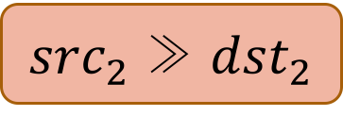
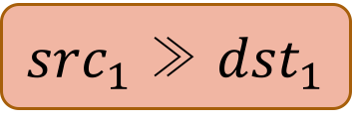
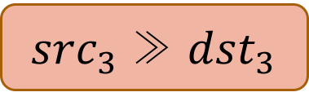
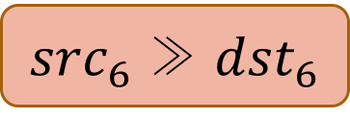
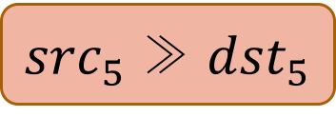

Divide-and-Conquer: Policy Graph Components
${src}_{1}$ ≫ ${dst}_{1}$
Isolation
${src}_{2}$ ≫ ${dst}_{2}$
Reachability Policy
${src}_{3}$ ≫ ${dst}_{3}$
Synthesis
${src}_{4}$ ≫ ${dst}_{4}$
${src}_{5}$ ≫ ${dst}_{5}$
${src}_{6}$ ≫ ${dst}_{6}$
Policy Graph
Notes:
The other optimization is called divide-and-conquer synthesis and let us now look at the intuition behind this. Let
Us represent the input policies as a graph<N>
Where each node represents a reachability policy <N>
And an edge says these paths are isolated from one other. We do not consider any other kind of policy here.<N>
Suppose we want to synthesize forwarding tables for this input. We can observe the two graph components do not affect each other<N>
We can split the policy graph into connected components and synthesize them independently

Slide 24
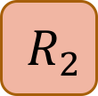
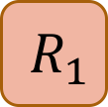
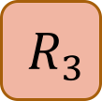
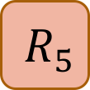
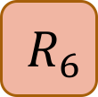
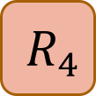
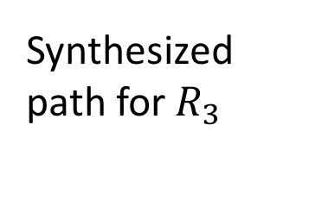
Divide-and-Conquer Synthesis
Multiple solutions exist due to dense topology
$${ R}_{1}$$
$${ R}_{2}$$
Synthesize partition 1
$${ R}_{3}$$
Synthesized path for${ R}_{3}$
Min-cut partitioning
Unsatisfiable cores for
iterating solutions
$${ R}_{4}$$
2x speedup for 40% of workloads with isolation
$${ R}_{5}$$
$${ R}_{6}$$
Synthesize partition 2
Notes:
The divide-and-conquer approach build on this intuition. <N>
As the name suggests, we divide the input policy graph into partitions along the min-cut <N>
First we synthesize only partition 1, <N>
and using the solution for R3, we synthesize partition 2 to get a solution for the entire input. <N>
This heuristic works because there exists multiple solutions, so the solver can “guess” a solution correctly without the complete input <N>
For example, synthesis of partition 2 could fail, and we use unsatisfiable cores to iterate through solutions for Partition 1 <N>
Divide-and-conquer can achieve a 2x speedup wrt baseline for 40% of workloads which have isolation policies.

Slide 25
Outline of the Talk
Motivation
Synthesis of forwarding tables in Genesis
Scaling Genesis: Tactics and Divide-and-Conquer
Genesis extensions: Handling failures
Notes:
Till now, we looked at synthesis of forwarding tables and different optimizations.
Now, we will look at two extensions to Genesis for handling network failures.

Slide 26
Genesis Extensions
Genesis
Rich Policy
Language
Synthesis using SMT
Resilient
Paths
Network Repair
Notes:
One of the primary design goals of Genesis is extensibility. <N>
Which we achieve by supporting a rich policy language and using SMT.
This helps in two seamless extensions to handle network failures without major modifications <N>
The first uses the rich policy language of Genesis for resilience, and <N>
And the second extension uses MaxSMT for repairing the network.

Slide 27

Network Resilience
Single path: Not resilient
Cloud network
Link failure
S1
S2
S3
t-resilience: For events under t arbitrary link failures,
there exists a valid path
Notes:
An important property required in high-failure networks is resilience. Consider the
Tenant path shown here. <N>
A link failure breaks connectivity, thus a single path is not resilient to failures. <N>
Thus, a tenant may require stronger guarantees, one such property is t-resilience, which says that under
T link failures, there must exist a valid path for the tenant.

Slide 28
Policy-compliant Resiliency
Cloud network
Backup path
Isolation policy
1-resilient
S1
S2
S3
Sound transformation of input policies to provide t-resilience
For 1-resilience, backup path must be edge-disjoint from original path
Notes:
In Genesis, the tenant can specify the resilience required. In this case, we require 1-resilience. <N>
For this, we require a backup path for the tenant. <N>
However, the backup patj must be edge-disjoint to tolerate any single link failure. <N>
This is where the rich policy language comes in use, we can specify an isolation policy to obtain edge-disjoint paths for the tenant. <N>
Genesis can provide resilience by simply transforming input policies, and this transformation is sound.

Slide 29
Minimal Reactive Network Repair
Cloud network
Policies
Policies
Best repair: Minimize change overhead
Genesis uses MaxSMT
Notes:
However, installing backup paths in the network consumes more memory in the network and can only handle a bounded number of failures. Genesis has a repair mechanism to tackles network failures reactively.Consider a cloud network, the lines here indicate the paths used by the tenants. <N>
A link failure can lead to policy violations and we need to repair the network.<N> By repair, I mean finding a new solution such such that all policies are satisfied.
In fact, there exists multiple solutions. However, the new solution could be completely different from the older one, and prior work has shown that switch updates can be expensive<N>
Thus, the best repair is a solution which minimizes the overhead of changing the forwarding rules <N>
Because Genesis uses SMT, we can use MaxSMT to find the minimal network repair.

Slide 30
Network Repair Evaluation
Multi-tenant isolation workload
One switch-failure, network repair such that number of switches affected is minimized
For larger workloads, repair is faster than re-synthesis.
Notes:
Let us see how this repair performs with respect to simply synthesizing the network.
We consider the multi-tenant isolation workload and a single switch failure, and find a minimal repair.
There are two phases in the graph: <N>
In the first phase, repair takes more time than synthesis because the network is under-utilized and repair has an optimization objective. <N>
For larger workloads, the time to synthesize the repair is lower than complete synthesis, and also minimizes the overhead.

Slide 31
High-level policies on paths
and switches
Genesis
Switch forwarding tables satisfying policies
INPUT
OUTPUT
Tactics
Divide-and-conquer
T-resilience Network repair
Optimizations
Extensions
Notes:
Thus, in conclusion, we presented a generalized synthesis framework for enforcing policies in multi-tenant clouds. We discussed various domain-specific optimizations to improve the synthesis performance and various seamless extensions to handle network failure scenarios.
Thank you for your attention and I would like to address any questions.
<Last Slide>

Slide 32
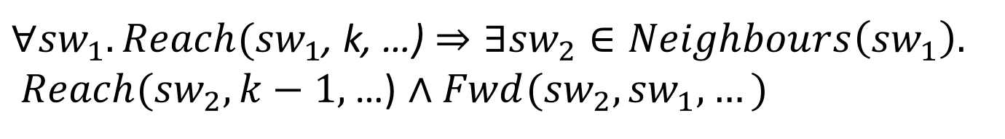
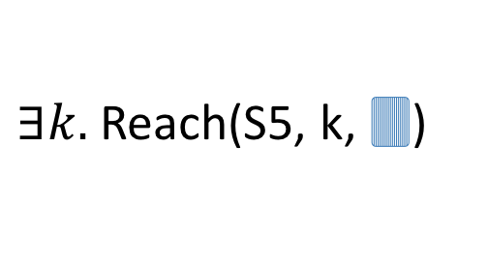
Valid Path Constraints
Reach(S2, k-1, 🀫)
Reach(S4, k, 🀫)
Blue Tenant 🀫 Reachability policy:
S1 >> S5
S4
S2
S4
S2
Fwd(S2,S4,🀫)
Reach(S1, 0, 🀫)
S1
S5
Fwd(S5,S4,🀫)
S5
Reach(S5, k-1, 🀫)
Source
$∃k.$Reach(S5, k, 🀫)
Destination
S3
$∀{sw}_{1}. Reach({sw}_{1}$, k, …)$⇒∃{sw}_{2}∈Neighbours\left({sw}_{1}\right).$
$Reach({sw}_{2}, k−1,$ …) $∧Fwd({sw}_{2}, {sw}_{1}, …)$

Slide 33
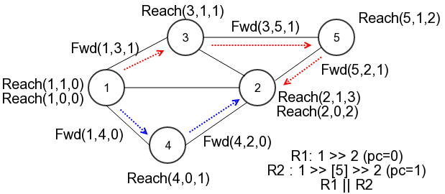
Synthesis Algorithm
Initialize networking model relations Fwd and Reach in Z3 Solver
Add constraints for the input policies to the solver
Solve and extract the set of paths from the solution model

Slide 34
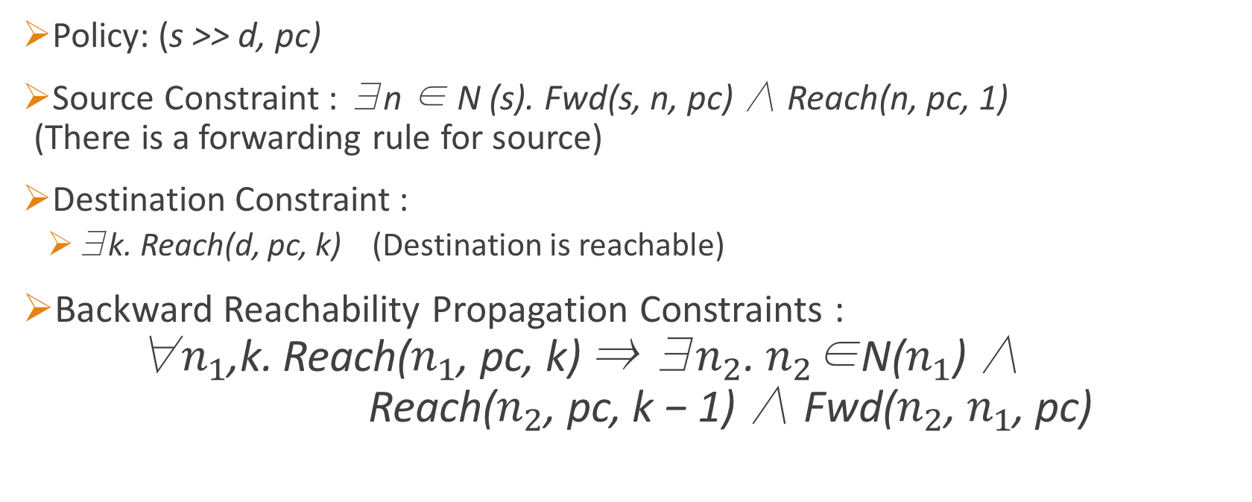
Reachability Constraints
Policy: (s >> d, pc)
Source Constraint : ∃n ∈ N (s). Fwd(s, n, pc) ∧ Reach(n, pc, 1) (There is a forwarding rule for source)
Destination Constraint :
∃k. Reach(d, pc, k) (Destination is reachable)
Backward Reachability Propagation Constraints : ∀$n_{1}$,k. Reach($n_{1}$, pc, k) ⇒ ∃$n_{2}$. $n_{2}$∈N($n_{1}$) ∧ Reach($n_{2}$, pc, k − 1) ∧ Fwd($n_{2}$, $n_{1}$, pc)
Notes:
Backward Reach : Ensures the path is valid
With source and destination constraints, we get a path from the model.
Quantifiers are unrolled using conjunction and disjunction.

Slide 35
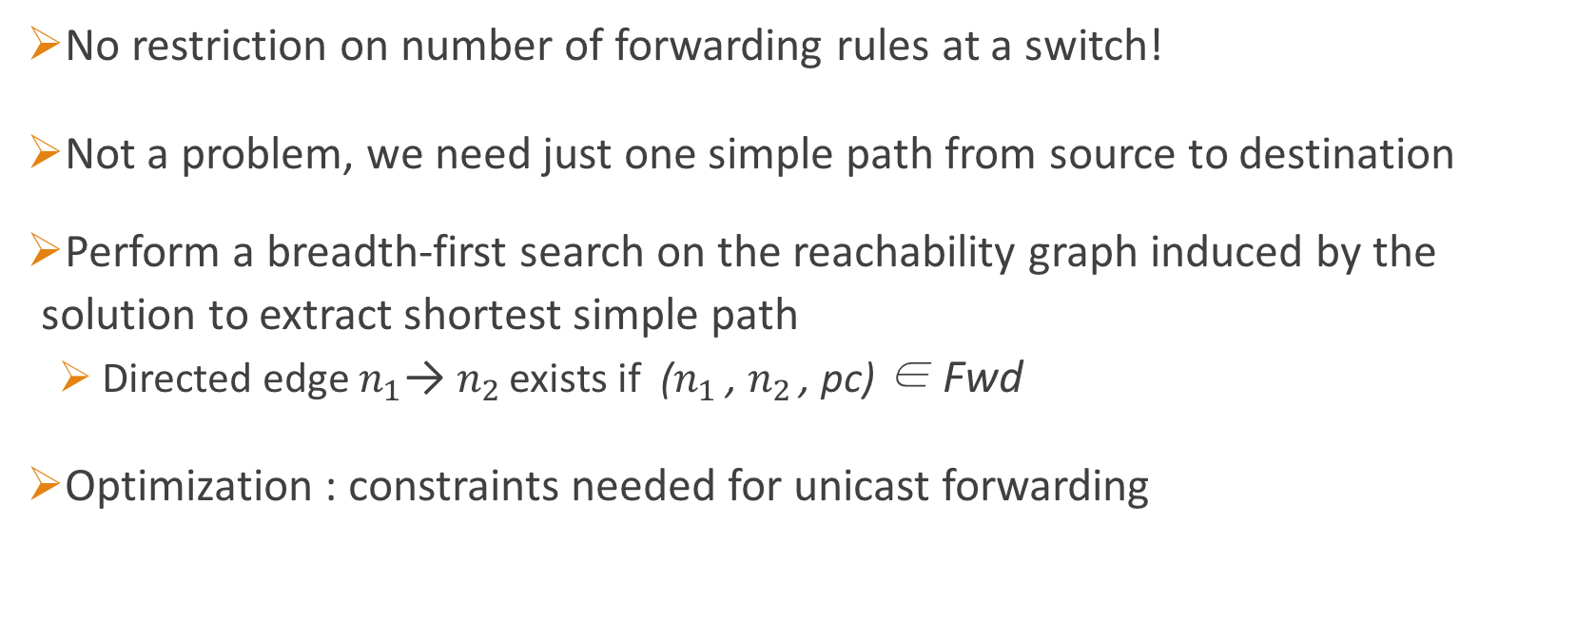
Unicast Forwarding?
No restriction on number of forwarding rules at a switch!
Not a problem, we need just one simple path from source to destination
Perform a breadth-first search on the reachability graph induced by the solution to extract shortest simple path
Directed edge $n_{1}\text{→ }n_{2 }$exists if ($n_{1}$ , $n_{2 }$, pc) ∈ Fwd
Optimization : constraints needed for unicast forwarding
Notes:
Multiple paths,
Unicast means a switch forwards the packet to only one switch, not multiple.

Slide 36
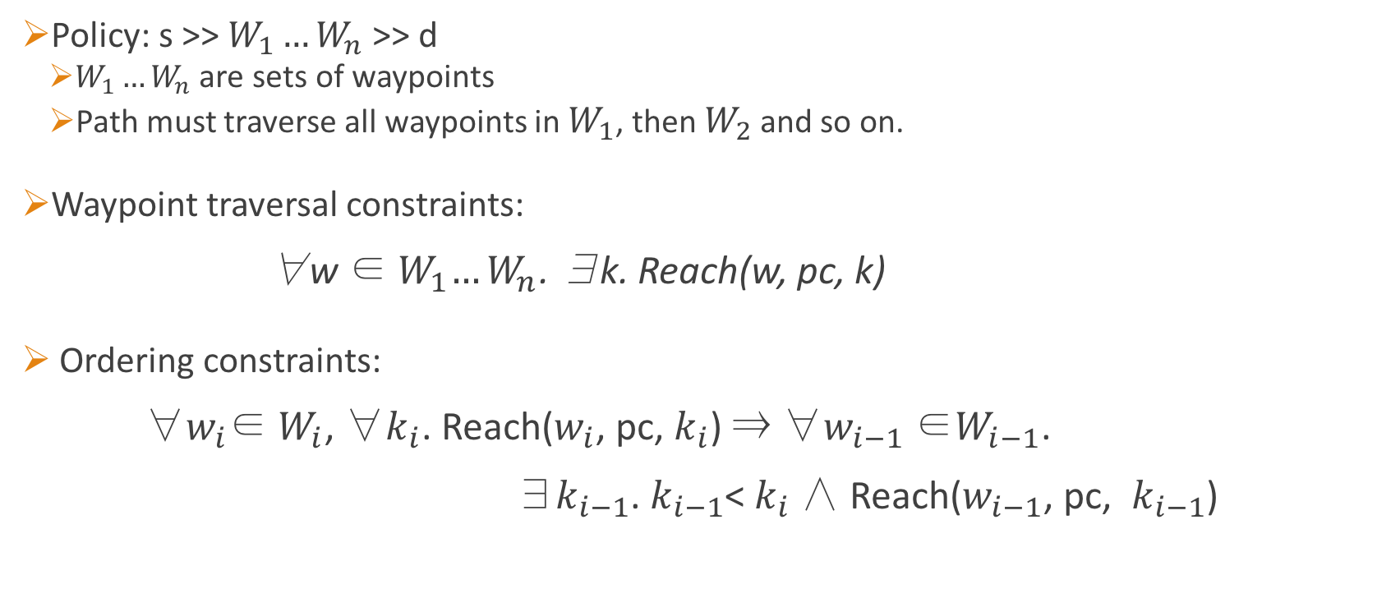
Waypoint Constraints
Policy: s >> $W_{1}…W_{n}$ >> d
$W_{1}…W_{n}$ are sets of waypoints
Path must traverse all waypoints in $W_{1}$, then $W_{2}$ and so on.
Waypoint traversal constraints: ∀w ∈${ W}_{1}…W_{n}$. ∃k. Reach(w, pc, k)
Ordering constraints: ∀$w_{i}$∈ $W_{i}$, ∀$k_{i}$. Reach($w_{i}$, pc, $k_{i}$) ⇒ ∀$w_{i−1}$ ∈$W_{i−1}$. ∃$k_{i−1}$. $k_{i−1}$< $k_{i}$∧ Reach($w_{i−1}$, pc, $k_{i−1}$)

Slide 37
Unicast Constraints
Waypoints : Need to ensure a single path from source to destination
Forwarding Set of switch sw is the set of switches the packet is forwarded to: FwdSet(sw, pc) = {k | Fwd(sw, k, pc)}
Forwarding rules for pc at a switch must not be greater than 1 : ∀sw, pc. |FwdSet(sw, pc)|≤ 1
Expressed using SAT
Notes:
Waypoints may be reachable on different paths without unicast constraints,
Which is not desired.

Slide 38
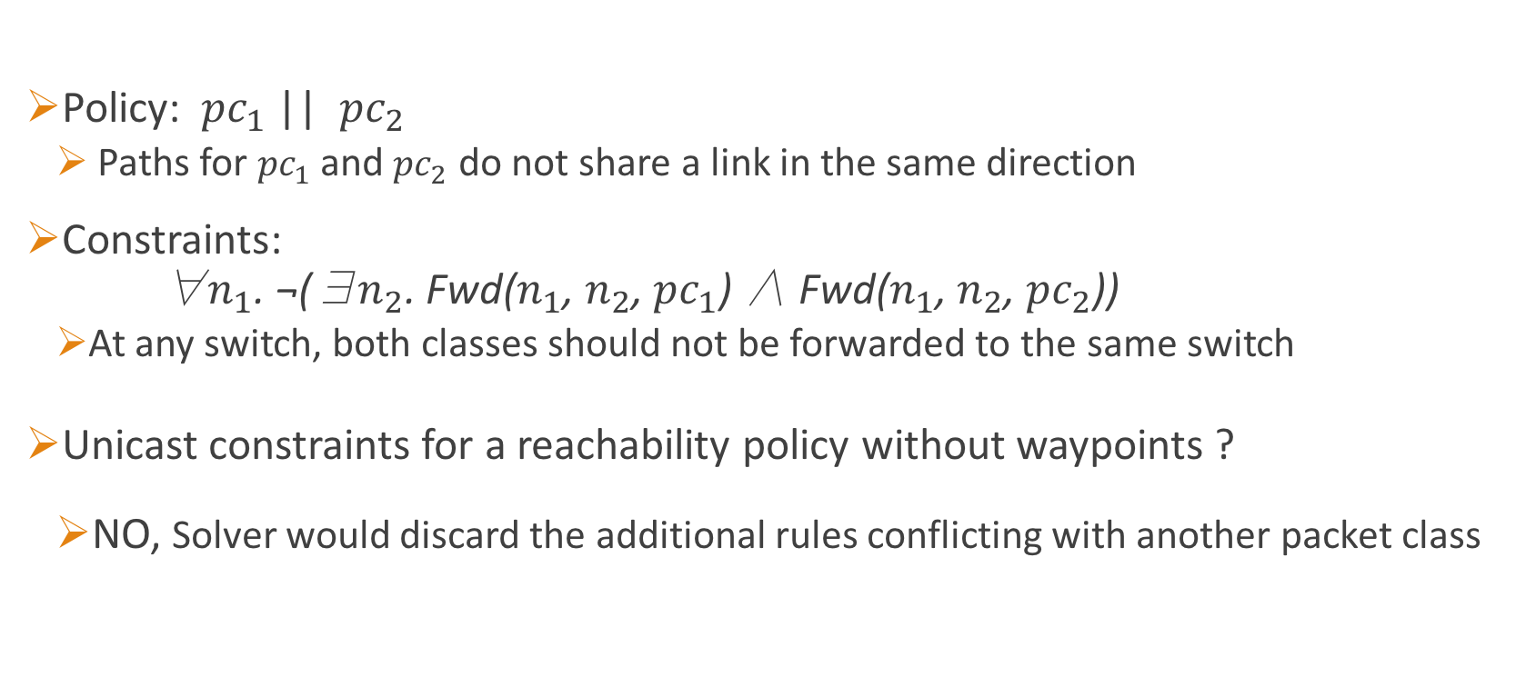
Isolation Constraints
Policy: ${ pc}_{1}$ || ${pc}_{2}$
Paths for ${pc}_{1}$and ${pc}_{2}$ do not share a link in the same direction
Constraints: ∀$n_{1}$. ¬(∃$n_{2}$. Fwd($n_{1}$, $n_{2}$, ${pc}_{1}$) ∧ Fwd($n_{1}$, $n_{2}$, ${pc}_{2}$))
At any switch, both classes should not be forwarded to the same switch
Unicast constraints for a reachability policy without waypoints ?
NO, Solver would discard the additional rules conflicting with another packet class
Notes:
Directionality is to ensure traffic isolation

Slide 39
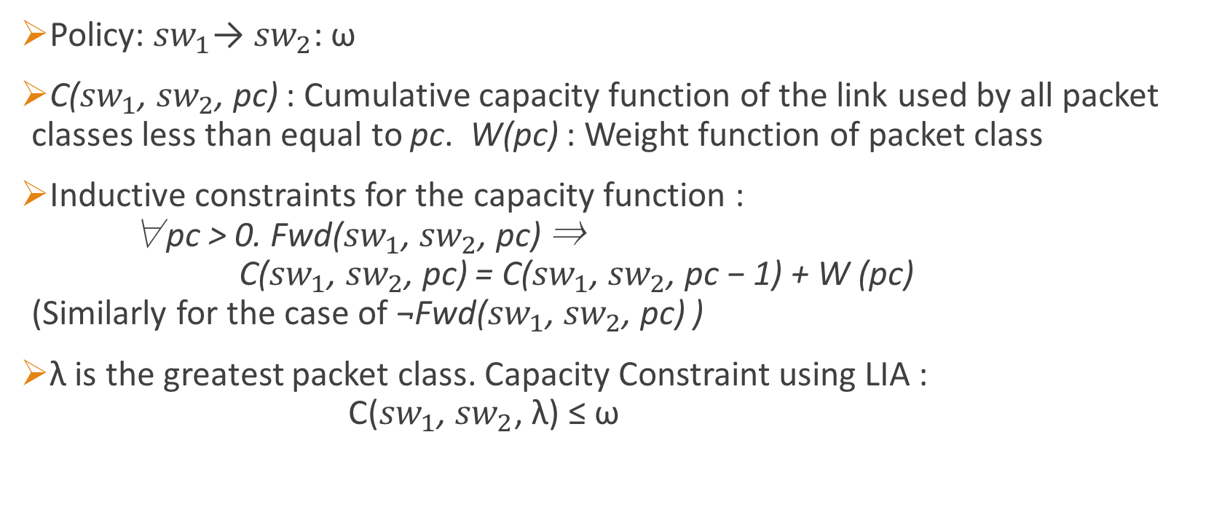
Link Capacity Constraints
Policy: ${sw}_{1}$→ ${sw}_{2}$: ω
C(${sw}_{1}$, ${sw}_{2}$, pc) : Cumulative capacity function of the link used by all packet classes less than equal to pc. W(pc) : Weight function of packet class
Inductive constraints for the capacity function : ∀pc > 0. Fwd(${sw}_{1}$, ${sw}_{2}$, pc) ⇒ C(${sw}_{1}$, ${sw}_{2}$, pc) = C(${sw}_{1}$, ${sw}_{2}$, pc − 1) + W (pc) (Similarly for the case of ¬Fwd(${sw}_{1}$, ${sw}_{2}$, pc) )
λ is the greatest packet class. Capacity Constraint using LIA : C(${sw}_{1}$, ${sw}_{2}$, λ) ≤ ω

Slide 40
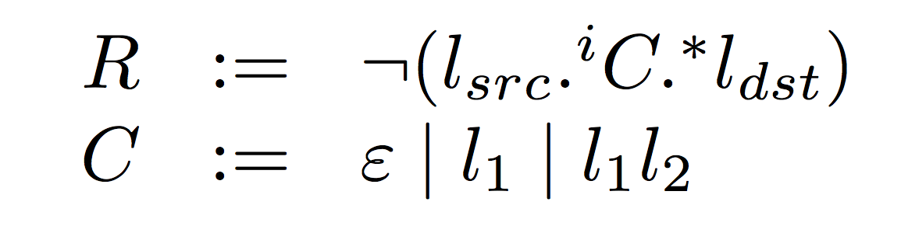
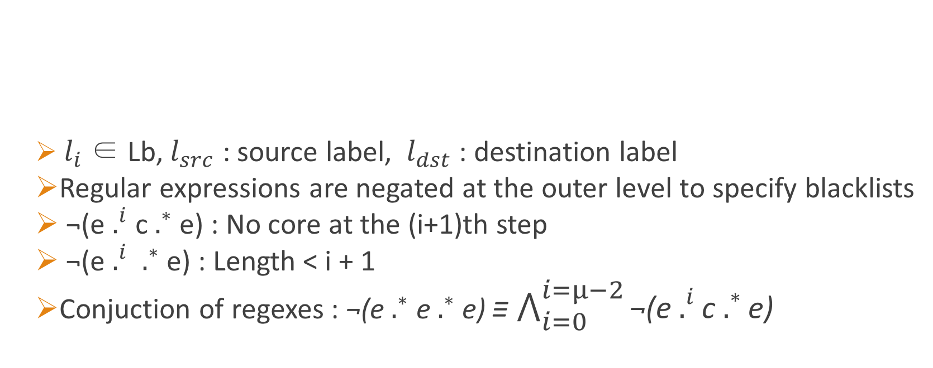
Restricted Tactic Syntax
$l_{i}$ ∈ Lb,${ l}_{src}$ : source label, ${ l}_{dst}$ : destination label
Regular expressions are negated at the outer level to specify blacklists
¬(e $.^{i}$ c $.^{∗}$ e) : No core at the (i+1)th step
¬(e $.^{i}$ $.^{∗}$ e) : Length < i + 1
Conjuction of regexes : ¬(e $.^{∗}$ e $.^{∗}$ e) ≡ $\bigwedge_{i=0}^{i=µ−2}{\text{¬(}\text{e} .^{i}\text{c} .^{∗}\text{e}\text{)}}$

Slide 41
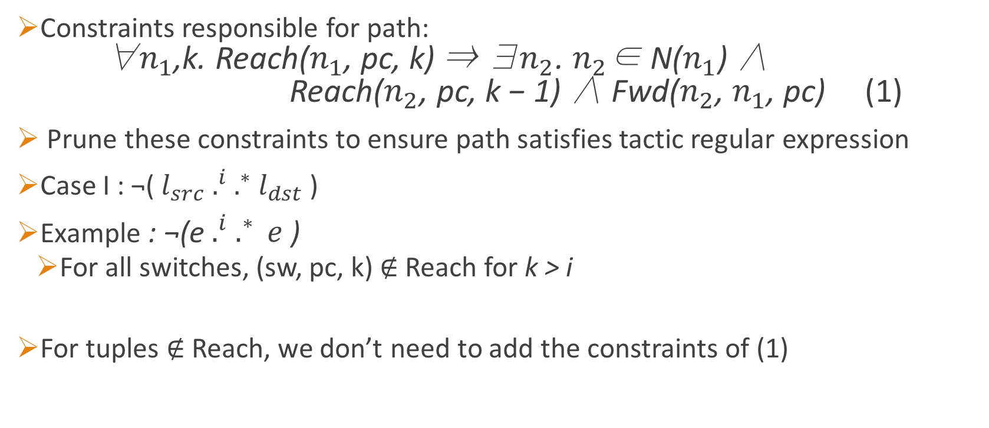
Tactic Synthesis Algorithm
Constraints responsible for path: ∀$n_{1}$,k. Reach($n_{1}$, pc, k) ⇒ ∃$n_{2}$. $n_{2}$∈ N($n_{1}$) ∧ Reach($n_{2}$, pc, k − 1) ∧ Fwd($n_{2}$, $n_{1}$, pc) (1)
Prune these constraints to ensure path satisfies tactic regular expression
Case I : ¬(${ l}_{src}{ .}^{i} .^{∗}{ l}_{dst}$ )
Example : ¬(e${ .}^{i} .^{∗} e$ )
For all switches, (sw, pc, k) $∉$Reach for k > i
For tuples $∉$Reach, we don’t need to add the constraints of (1)
Notes:
Explain the intuition of tactics from (1).

Slide 42
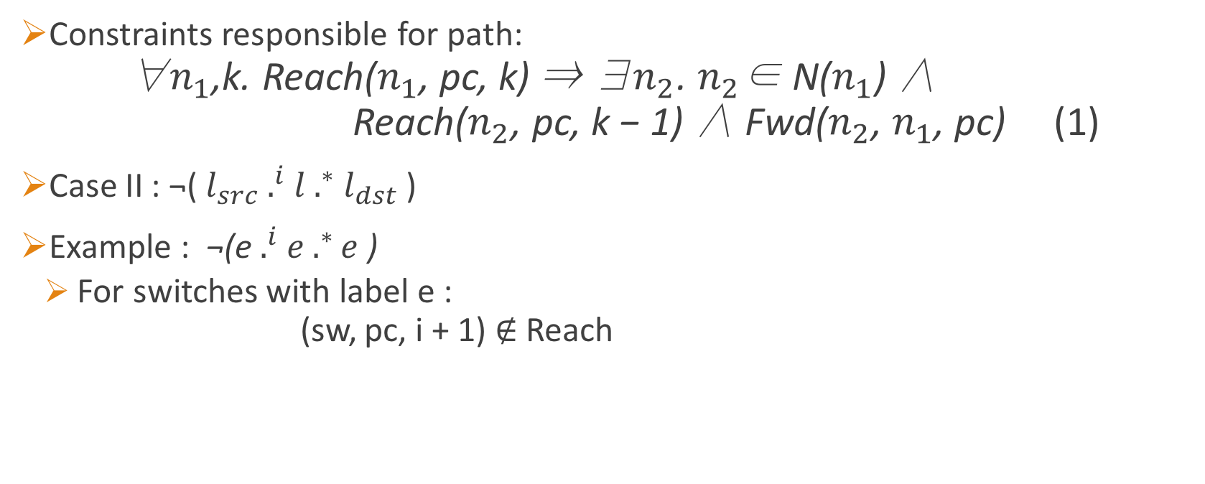
Tactic Synthesis Algorithm
Constraints responsible for path: ∀$n_{1}$,k. Reach($n_{1}$, pc, k) ⇒ ∃$n_{2}$. $n_{2}$∈ N($n_{1}$) ∧ Reach($n_{2}$, pc, k − 1) ∧ Fwd($n_{2}$, $n_{1}$, pc) (1)
Case II : ¬(${ l}_{src}{ .}^{i} l .^{∗}{ l}_{dst}$ )
Example : ¬(e${ .}^{i} e .^{∗}e$ )
For switches with label e : (sw, pc, i + 1) $∉$Reach
Notes:
l_src .^I l_dst satisfies ¬(${ l}_{src}{ .}^{i} l .^{∗}{ l}_{dst}$ )

Slide 43
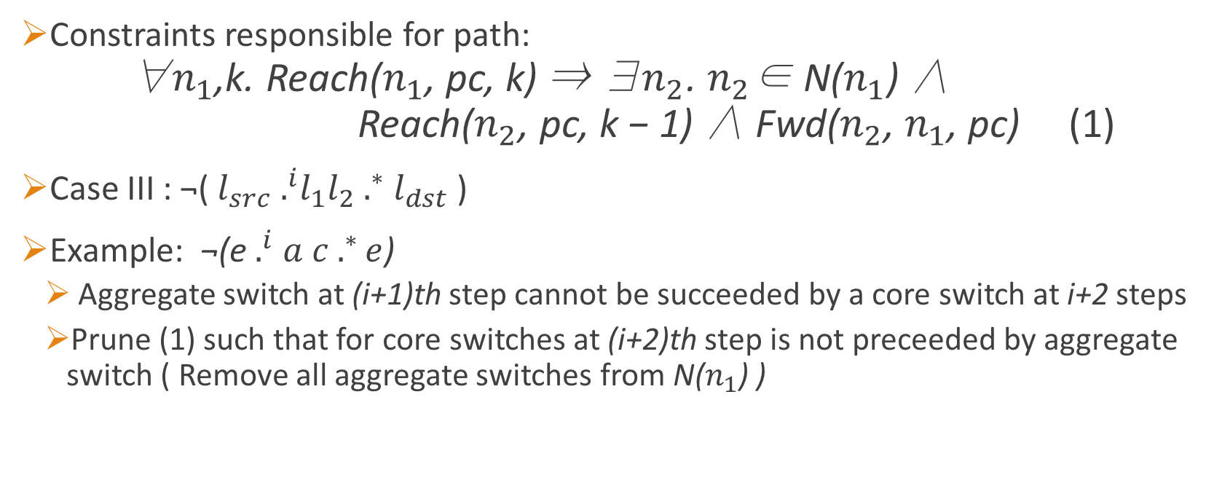
Tactic Synthesis Algorithm
Constraints responsible for path: ∀$n_{1}$,k. Reach($n_{1}$, pc, k) ⇒ ∃$n_{2}$. $n_{2}$∈ N($n_{1}$) ∧ Reach($n_{2}$, pc, k − 1) ∧ Fwd($n_{2}$, $n_{1}$, pc) (1)
Case III : ¬(${ l}_{src}{ .}^{i}l_{1}l_{2} .^{∗}{ l}_{dst}$ )
Example: ¬(e${ .}^{i} a c .^{∗}e$)
Aggregate switch at (i+1)th step cannot be succeeded by a core switch at i+2 steps
Prune (1) such that for core switches at (i+2)th step is not preceeded by aggregate switch ( Remove all aggregate switches from N($n_{1}$) )
Notes:
l_src .^I l_dst satisfies ¬(${ l}_{src}{ .}^{i} l .^{∗}{ l}_{dst}$ )

Slide 44
Network
Operator
Tenant Specifications
Operator Specifications
Reachability
Waypoints
Isolation
Genesis
Policies
Link Capacity
Switch Table Size
Traffic Engineering
?
Genesis
Forwarding
Tables
SDN Controller
FW
C1
C2
IDS
A1
A2
A3
A4
E1
E2
E3
E4
Notes:
Network Operator in a multi-tenant cloud datacenter.
SDN overview : programmable switches, centralized controller
Tenant Requirements. Network QoS and Resource Management
? : Existing frameworks too low-level (individual switches) or tailor-made for specific policies (hard to extend)
Need a generalised framework which abstracts the low-level details.

Slide 45
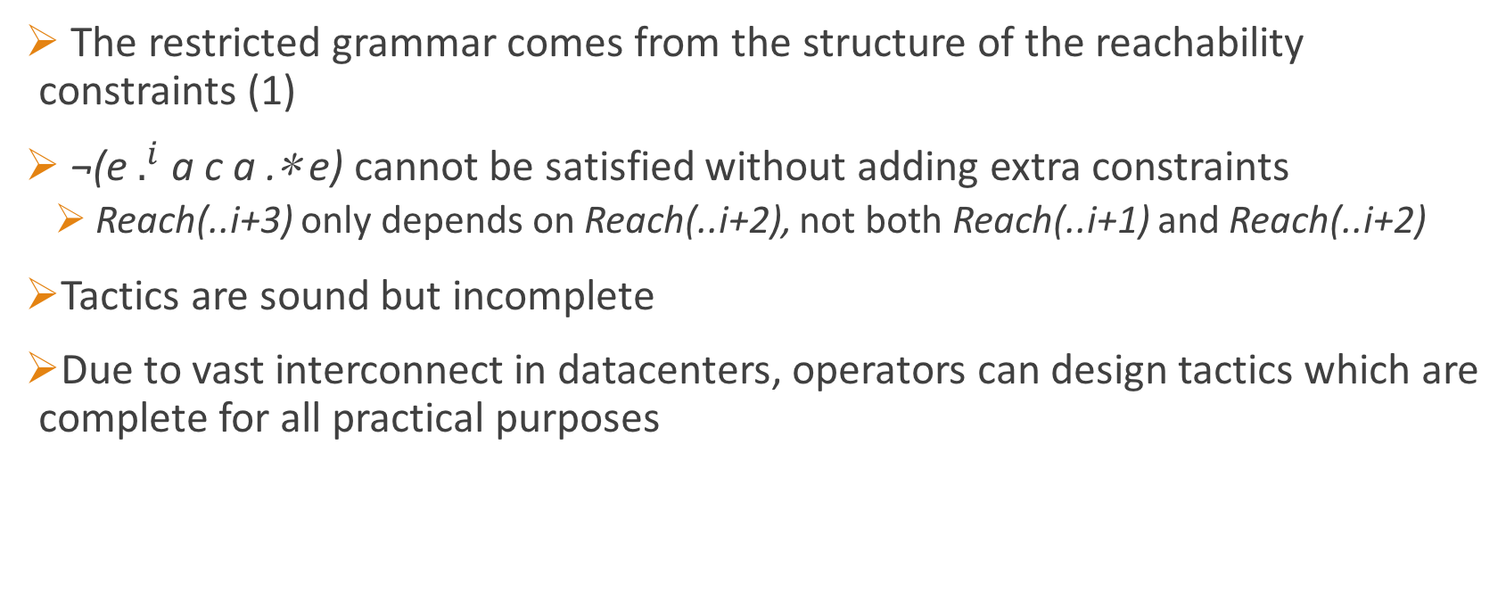
Tactics
The restricted grammar comes from the structure of the reachability constraints (1)
¬(e $.^{i}$ a c a .∗ e) cannot be satisfied without adding extra constraints
Reach(..i+3) only depends on Reach(..i+2), not both Reach(..i+1) and Reach(..i+2)
Tactics are sound but incomplete
Due to vast interconnect in datacenters, operators can design tactics which are complete for all practical purposes
Notes:
Explain regex example.

Slide 46
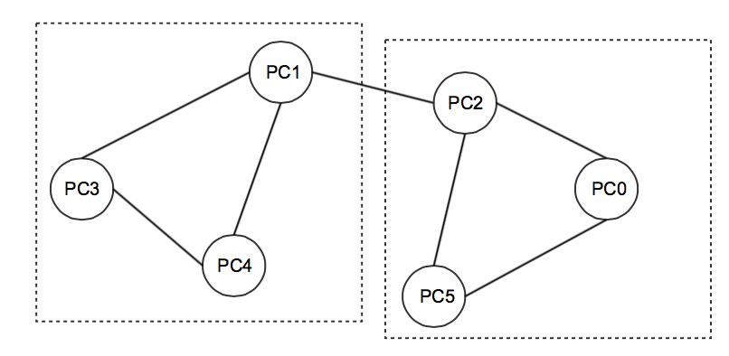
Synthesis Procedure
Policy Graph : Vertices are packet classes and edges are isolation policies
Recursively partition each connected component in two : min-cut partitioning/ equi-sized partitioning
Maximize isolation inside partitions
Synthesize P1, and provide the solution of P1 to P2 as constraints for synthesis
Notes:
Min-cut can give small partitions like a single vertex in a dense graph. Then use equi-sized partitions.
Recursively partition till a threshold
Since synthesis of partitions independently, we want to minimize the inter-partition edges
Best case : not connected at all!
Say about link capacities : clique inter-relation

Slide 47
Recovery Mechanisms
Path1
Path2
Synthesis
Path1
Synthesis

Slide 48
Recovery Mechanisms
Solver-guided enumeration :
Obtain unsatisfiable cores which are paths of P1
Resynthesize P1 to get a different solution
Enumeration ineffective with dense graphs, bound of number of enumerations
For completeness, perform multiple iterations of optimistic synthesis:
Each iteration, double the base threshold partition size
Final case : threshold = graph size (normal synthesis)
Notes:
Unsat cores : Z3 feature (does not give min unsat cores)
Base graph larger, better chances of success. Don’t want to from small -> largest,
Go step by step

